Slide 1
Preorder Traversal
Process the root R.
Traverse the left subtree of R in preorder.
Traverse the right subtree of R in preorder.

Slide 2
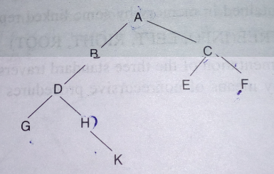
Example

Slide 3
1.) Stack=null.
Then set PTR:=A.
2.) Now proceed the left most part rooted at PTR:=A.
Process:=A
Stack:=null,C(push right child C onto stack)
Process:=B
Process:=D
Stack:=null,C,H(push right child H onto stack)
Process:=G

Slide 4
3.)Since G has no left child, so no other node is processed. That is why just perform backtracking.
Pop:=H(top element) and set PTR:=H, stack:=null,C
4.)Proceed the left most part rooted at PTR:=H.
Process:=H and push right child K onto stack.
Stack:=null,C,K.
No other node is processed since H has no left child.

Slide 5
5.)Pop:=K and PTR:=K
Stack:=null, C.
6.)Proceed down the left most part rooted at PTR:=K.
Process:=K
K has no left child, so no other node is processed.

Slide 6
7.)Pop:=C and PTR:=C and set Stack:=null.
8.)Proceed the left most part rooted at PTR:=C
Process C and put its ight child F onto stack.
Stack:=null, F.
Process:=E(E has no right child)
No other node is processed since E has no left child.
9.)[Backtracking]Pop:=F and set PTR:=F and stack:=null.
10.)Proceed down the left most part rooted at PTR:=F.
Process:=F and it doesn’t have right child.
No other node is processed since F has no left child.
11.)[Backtracking]Pop:=null and set PTR:=null.

Slide 7
Solution:=
A,B,D,G,H,K,C,E,F

